Slide 1

Houston, TX
2019
#XamDevSummit

Slide 2




Xamarin.Forms Made Better With Prism
Hussain N. Abbasi
Manager at Sogeti (Capgemini)
HussainNAbbasi
HussainAbbasi.com
HNAbbasi
Notes:
Intro
Talk about Vanilla XF and why it is not ideal for MVVM

Slide 3


Slide 4
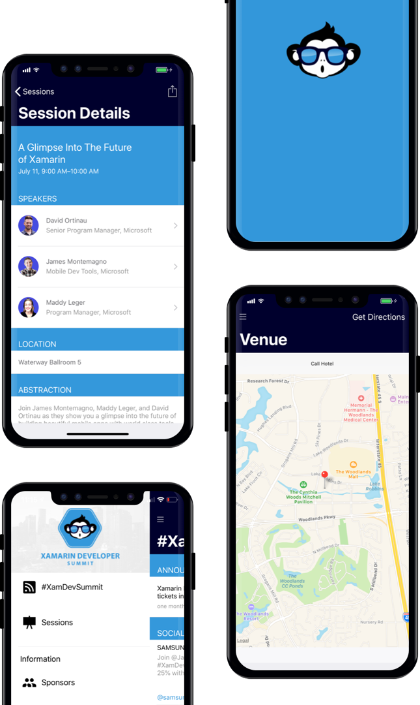
AGENDA
Download our Xamarin based mobile app: XamDevSummit.

Slide 5

PRISM

Slide 6
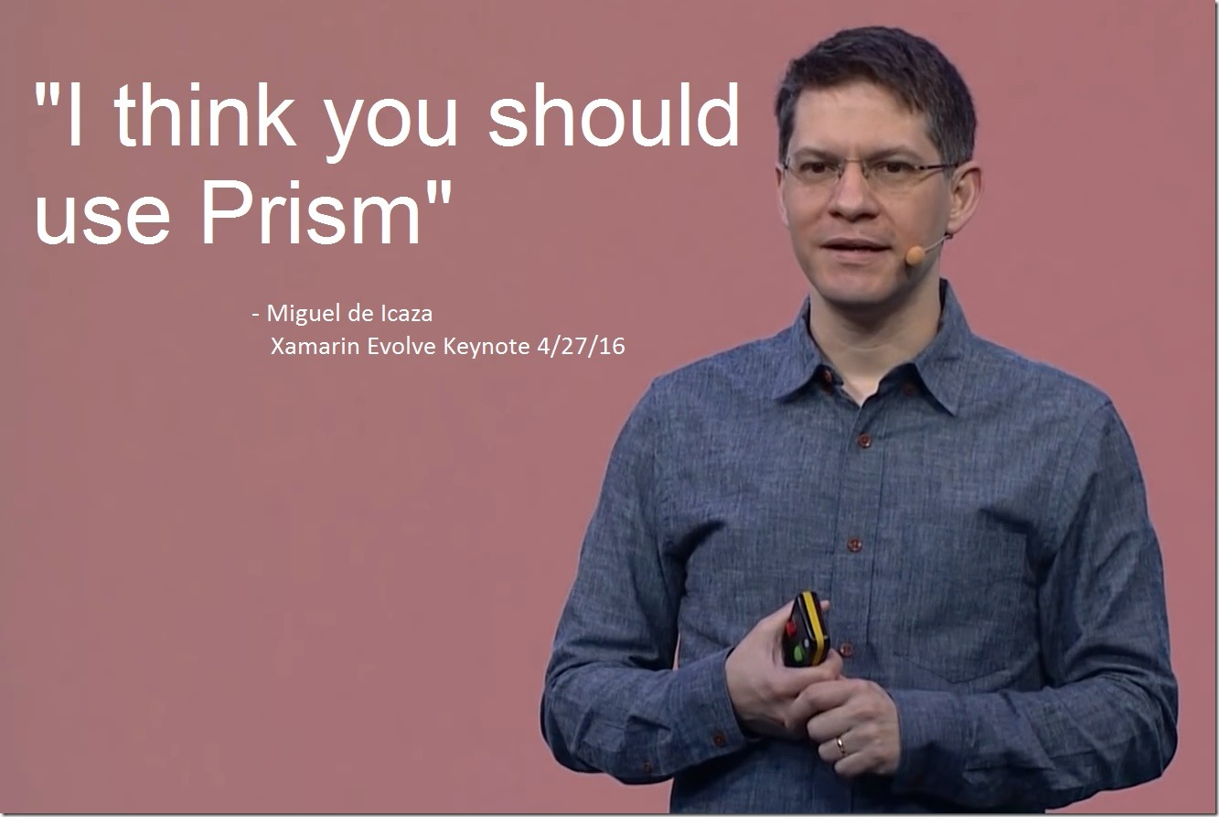
👀
Notes:
PRISM: Developed by MS patterns and practices team, Open-sourced later. Works great for XAML based application.

Slide 7
What is Prism?
XAML Application Framework
Patterns & Practices
Testable, Maintainable
Open Source – http://github.com/PrismLibrary
& Transferrable
Notes:
PRISM: Developed by MS patterns and practices team, Open-sourced later. Works great for XAML based application.

Slide 8
PRISM.FORMS
ObserveProperty
INavigationParameter
RegisterMany
IAutoInitialize
MVVM
Modules
ContainerProvider
DependencyResolver
OnNavigatedTo
PageDialogService
AutoRegister
EventAggregator
..\..\
SwitchTab
OnNavigatedFrom
IDialogService
Logging
NavigationResult
DelegateCommand
ICanNavigate
PartialViews
XAML Navigation
PubSub
EventToCommandBehavior
ViewModelLocator

Slide 9
PRISM.FORMS
ObserveProperty
INavigationParameter
RegisterMany
IAutoInitialize
MVVM
Modules
ContainerProvider
DependencyResolver
OnNavigatedTo
AutoRegister
EventAggregator
..\..\
SwitchTab
OnNavigatedFrom
IDialogService
NavigationResult
DelegateCommand
PartialViews
ICanNavigate
XAML Navigation
PubSub
EventToCommandBehavior
ViewModelLocator

Slide 10
Prism.Forms
MVVM Support
Commands
Navigation
IAutoInitialize
IDialogService
IEventAggregator
Modules

Slide 11



MVVM
View
ViewModel
Model
Binding
Presentation
Presentation Logic
Business Logic & Data

Slide 12
MVVM Vanilla
MainPage
MainPage ViewModel
public partial class MainPage : ContentPage
{
public MainPage()
{
InitializeComponent();
BindingContext = new MainPageViewModel();
}
}

Slide 13


ViewModel Locator

Slide 14
ViewModel Locator
View
ViewModel
Namespace
.Views
.ViewModels
configurable
LoginPage
LoginPageViewModel
PageA
PageAViewModel
ViewA
ViewAViewModel
SomeView
SomeViewModel
Notes:
MainView -> MainViewModel

Slide 15
ViewModel Locator
AutowireViewModel
XAML
xmlns:prism="http://prismlibrary.com" prism:ViewModelLocator.AutoWireViewModel="True"
C#
using Prism.Mvvm;
ViewModelLocator.SetAutowireViewModel(this, true);

Slide 16
Register For Navigation
AutowireViewModel
Autowire ON
.RegisterForNavigation<MainPage>();
.RegisterForNavigation<MainPage>(“main”);
Autowire OFF
.RegisterForNavigation<MainPage, MyViewModel>();
.RegisterForNavigation<MainPage, MyViewModel>(“main”);

Slide 17
Auto Register For Navigation
App or Module Level
[AutoRegisterForNavigation]
class App : PrismApplication
Page Level
[RegisterForNavigation]
class ViewA : PrismApplication
[RegisterForNavigation(Name = “viewB”)]
class ViewB : ContentPage

Slide 18

Commanding

Slide 19
Delegate Commands
DelegateCommand
public DelegateCommand SubmitCommand { get; set; }
SubmitCommand = new DelegateCommand(OnSumbitTapped);
void OnSumbitTapped() { // Handle it }
DelegateCommand<T>
public DelegateCommand<string> SubmitCommand { get; set; }
SubmitCommand = new DelegateCommand<string>(OnSumbitTapped);
void OnSumbitTapped(string commParam) { // Handle it }

Slide 20
Delegate Commands
ObservesProperty()
new DelegateCommand(OnSumbitTapped, CanExecute) .ObservesProperty(() => CanSubmit)
.ObservesProperty(() => CanContinue);

Slide 21

Navigation

Slide 22
Navigation
INavigationService
Task<INavigationResult> NavigateAsync(Uri/string, [INavigationParameters/Tuple<>]);
Task<INavigationResult> GoBackAsync([INavigationParameters/Tuple<>]);
INavigationResult
bool Success { get; } // Navigation was successful
Exception Exception { get; } // Or not
Notes:
Added Tuple support

Slide 23
Navigation
INavigationParameters
IEnumerable<KeyValuePair<string, object>>
INavigationAware
void OnNavigatedFrom (INavigationParameters parameters);
void OnNavigatedTo (INavigationParameters parameters);
IConfirmNavigation
bool CanNavigate (INavigationParameters parameters);

Slide 24
Navigation – Passing Parameters
INavigationParameters
Option A
params = new NavigationParameters {{“id”, 1}};
navigationService.NavigateAsync(“Page”, params);
Option B
navigationService.NavigateAsync(“Page?id=1”);
Option C-razy
params = new NavigationParameters(“?id=1”)
{ { “name”, “Hussain”} };
navigationService.NavigateAsync(“Page”, params);

Slide 25
Navigation – Reading Parameters
INavigationAware
void OnNavigatedTo(INavigationParameters parameters) {
if (parameters.ContainsKey("name"))
Name = parameters.GetValue<string>("name”);
}

Slide 26
Navigation – Reading Parameters
IAutoInitialize
class SomeViewModel : IAutoInitialize {
public string Name { get; set; }
}

Slide 27
Navigation
Deep Link
.NavigateAsync(“PageA/PageB/PageC”);
Deep Link with Parameters
.NavigateAsync(“PageA?id=1/PageB?id=2/PageC?id=3”);
Remove Page
.NavigateAsync(“../PageA/PageB”); // works with NavigationPage

Slide 28
Navigation
Reset Stack
.NavigateAsync(“/PageA”);
TabbedPage - Select Tab
.NavigateAsync(“PageA/PageB/PageC?selectedTab=TabC”);
TabbedPage - Switch Tab
.SelectTabAsync(“TabC”);

Slide 29
XAML Navigation
NavigateTo
xmlns:prism="clr-namespace:Prism.Navigation.Xaml;assembly=Prism.Forms"
Command=“{prism:NavigateTo PageA}”
Navigation Parameter
Command=“{prism:NavigateTo PageA}”
<_.CommandParameters> <prism:NavigationParameters>
<prism:NavigationParameter Key=“id” Value=“1”/> </prism:NavigationParameters>
</_.CommandParameters>

Slide 30
XAML Navigation
Go Back
Command=“{prism:GoBack}”
Go Back To Root
Command=“{prism:GoBack ToRoot}”

Slide 31

Event Aggregator
Notes:
Loosely coupled, event-based communication
Weak Events
Publisher-Subscriber (PubSub) Pattern
Pass payload
Cross-platform

Slide 32
IEventAggregator
Loosely coupled, event-based communication
Weak Events
Publisher-Subscriber (PubSub) Pattern
Pass payload
Cross-platform

Slide 33
IEventAggregator
PubSubEvent
class UpdateEvent : PubSubEvent { }
PubSubEvent<T>
class GreetEvent : PubSubEvent<object> { }

Slide 34
IEventAggregator
Publish
IEventAggregator.GetEvent<NoPayloadEvent>().Publish();
IEventAggregator.GetEvent<PayloadEvent>().Publish(payload);
Subscribe
IEventAggregator.GetEvent<NoPayloadEvent>().Subscribe(HandleEvent);
void HandleEvent() { }
IEventAggregator.GetEvent<PayloadEvent>().Subscribe(HandlePayload);
void HandlePayload(object payload) { }

Slide 35
IEventAggregator
AppDelegate (iOS) / MainActivity (Android)
var app = new App();
app.Container
.Resolve<IEventAggregator>()
.GetEvent<GreetEvent>()
.Subscribe(OnMessageReceived);
LoadApplication(app);
Notes:
Works cross-platform

Slide 36

Dialog Service

Slide 37
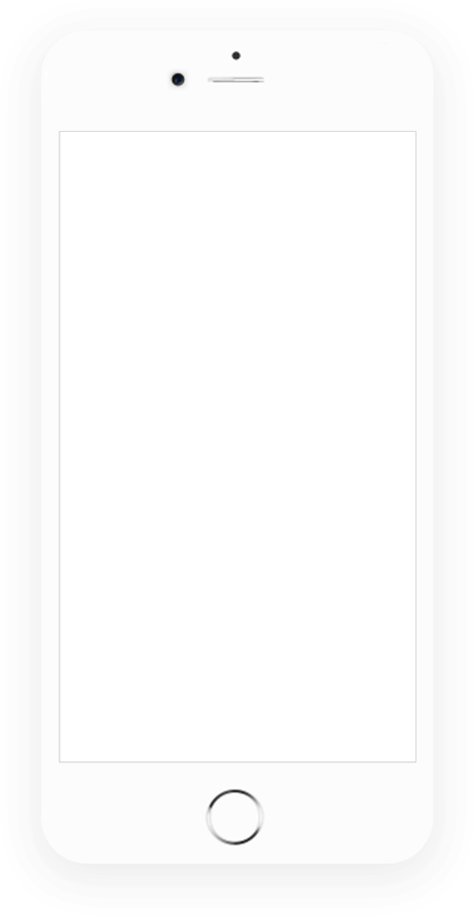
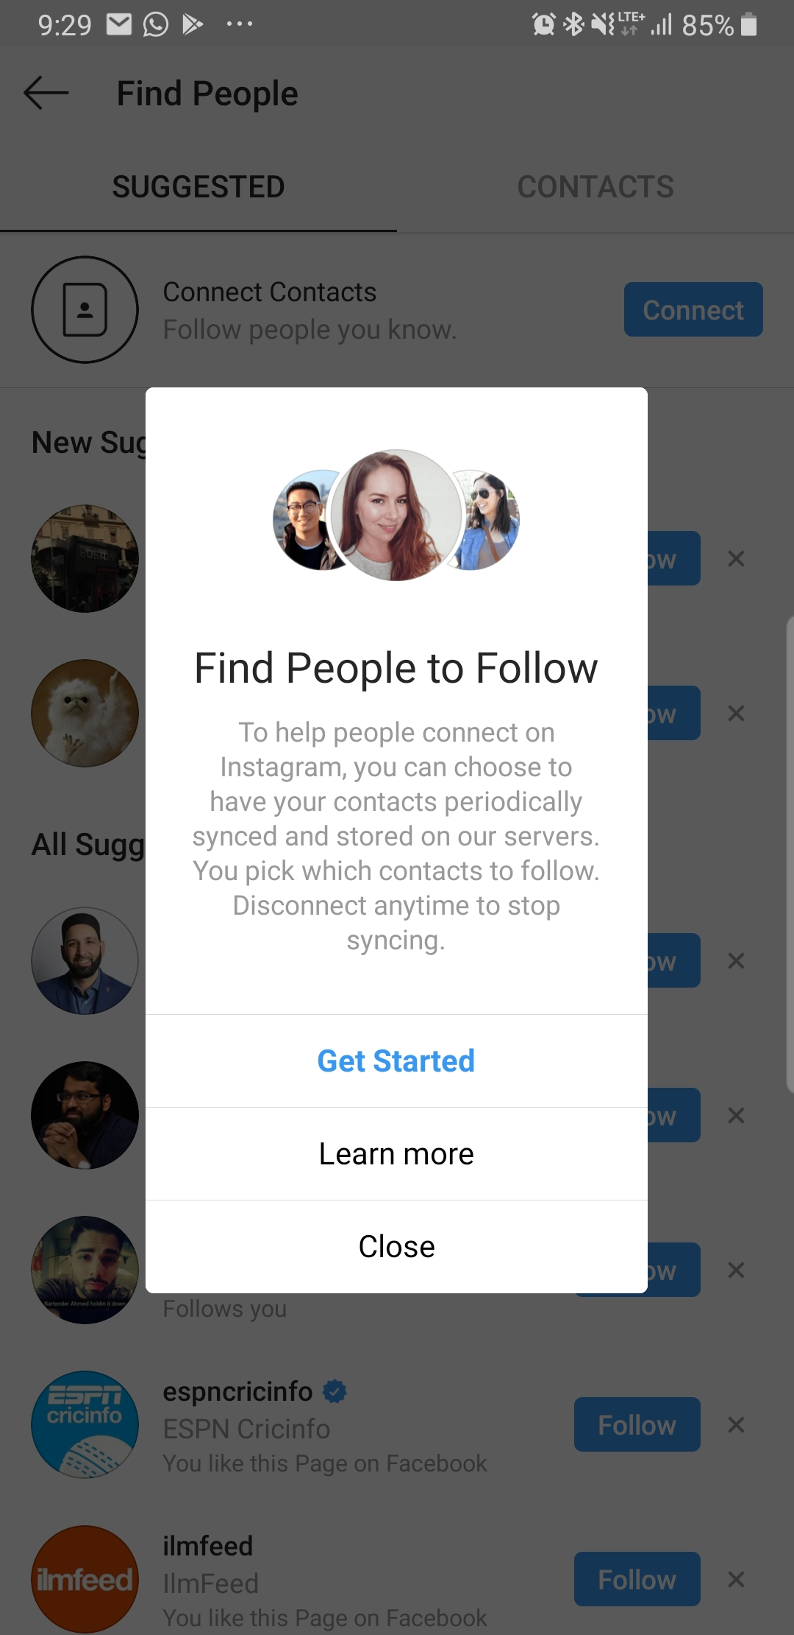
IDialogService
class SomeViewModel(IDialogService ds)
{
ds.ShowDialog(“MyDialogView”);
}
DialogView (e.g. ContentView)
DialogViewModel

Slide 38
IDialogService
DialogViewModel
class MyDialogViewModel : IDialogAware
IDialogAware
event Action<IDialogParameters> RequestClose;
bool CanCloseDialog()
void OnDialogClosed() { }
void OnDialogOpened(IDialogParameters parameters);
IDialogParameters
IEnumerable<KeyValuePair<string, object>>

Slide 39
IDialogService
Register Dialog
.RegisterDialog<MyDialogView>();
.RegisterDialog<MyDialogView>(“MyDialog”);
XAML
<Button Text="Show Dialog"
Command="{prism:ShowDialog ‘MyDialog?title=Alert&message=Hello'}" />

Slide 40
Modules

Slide 41

Modules
What is a Module?
A Module is a piece of code that you can load at runtime
Implements IModule
Can register dependencies
When to use Modules?
Distributed development teams
Code re-use (Authentication, utilities, etc.)
User based features, and more…

Slide 42
Modules
IModule
void OnInitialized(IContainerProvider containerProvider) { }
void RegisterTypes(IContainerRegistry containerRegistry) { }

Slide 43
Modules
ConfigureModuleCatalog
void ConfigureModuleCatalog(IModuleCatalog moduleCatalog) {
moduleCatalog.AddModule<ModuleA>();
moduleCatalog.AddModule<ModuleA>(InitializationMode.OnDemand);
}
InitializationMode
// At start up (DEFAULT)
InitializationMode.WhenAvailable
// Loaded by ModuleManager
InitializationMode.OnDemand

Slide 44
Modules
IModuleManager
IModuleManager.LoadModule(“ModuleName”)
IModuleCatalog
IEnumerable<IModuleInfo> IModuleCatalog.Modules { get; }
IModuleInfo
Name, Type, State, Initialization Mode, Dependencies

Slide 45
PRISM.FORMS
ObserveProperty
INavigationParameter
RegisterMany
IAutoInitialize
MVVM
Modules
ContainerProvider
DependencyResolver
OnNavigatedTo
PageDialogService
AutoRegister
EventAggregator
..\..\
SwitchTab
OnNavigatedFrom
IDialogService
Logging
NavigationResult
DelegateCommand
ICanNavigate
PartialViews
XAML Navigation
PubSub
EventToCommandBehavior
ViewModelLocator

Slide 46
Getting Started Prism
Documentation – https://prismlibrary.github.io
Code – http://github.com/PrismLibrary
Support - https://www.patreon.com/prismlibrary
@PrismLib | @BrianLagunas | @DanSiegel | @HussainNAbbasi

Slide 47
Q & A
HussainAbbasi.com
@HussainNAbbasi

Slide 48
Thank You!

